Slide 1
TOPICS FOR DISCUSSION
Monetary Policy (By RBI) & Fiscal Policy (Central Govt)
RBI’s main role is inflation control & Liquidity management (money supply)
CRR – Cash Reserve Ratio
SLR – Statutory Liquidity Ratio
REPO – Repurchase Option
REVERSE REPO

Slide 2
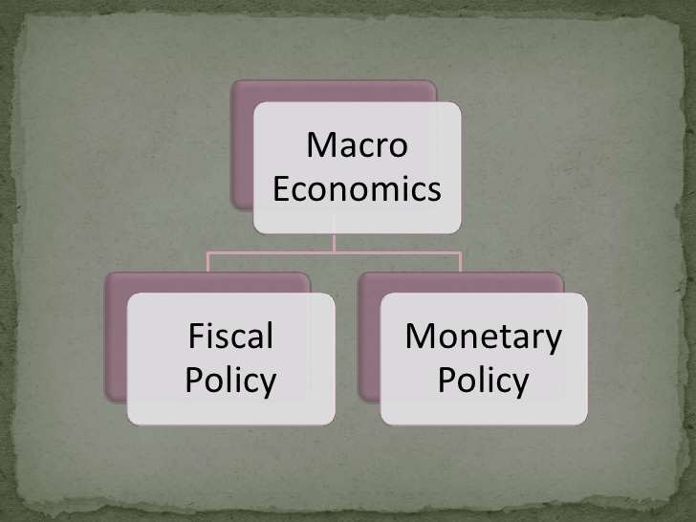
FISCAL & MONETARY POLICY

Slide 3
Monetary Policy
The central bank (RBI) to control and regulate the SUPPLY OF MONEY with the public and Flow Of Credit with the view of achieving MACROECONOMIC goals

Slide 4


Slide 5
REPO & REVERSE REPO
Repo Rate is the rate at which RBI lends money to commercial banks.
At present Repo Rate: 6.5%
Reverse Repo Rate is the rate at which RBI borrows money from the commercial banks.
At present Reverse Repo Rate 3.35%

Slide 6
CRR
Scheduled commercial Banks(SCBs) in India are required to hold a certain proportion of their Demand & Time Liabilities(DTL) with RBI as per Section 42 (1) of the Reserve Bank of India Act, 1934
This minimum ratio is stipulated by the RBI and is known as the CRR or Cash Reserve Ratio.
It is a tool used by RBI to control liquidity in the banking system
In simpler terms, as per Section 42(1) of the Reserve Bank of India Act, 1934, scheduled commercial banks (SCBs) in India must keep a certain percentage of the money deposited by customers (Demand & Time Liabilities or DTL) with the Reserve Bank of India (RBI). This requirement helps ensure the stability of the banking system and enables the RBI to regulate the money supply in the economy
Scheduled Commercial Banks (SCBs) are banks that are listed in the Second Schedule of the Reserve Bank of India Act, 1934. These banks are licensed and regulated by the Reserve Bank of India (RBI) and are subject to its prudential norms and regulations
One example of a scheduled commercial bank in India is the State Bank of India (SBI)

Slide 7
What is Demand Liabilities?
These are all liabilities which are payable on demand:
current deposits,
Demand liabilities portion of savings bank deposits,
Margins held against letters of credit / guarantees, balances in overdue fixed deposits,
cumulative/ recurring deposits,
outstanding Telegraphic Transfers (TTS), Mail Transfer (MTs), Demand Drafts (DDs),
unclaimed deposits, credit balances in the Cash Credit account and deposits heId as security for advances which are payable on Demand
Current deposits: These are funds kept in a bank account that can be withdrawn anytime without any prior notice. For example, the money you keep in your regular checking account.
Demand liabilities portion of savings bank deposits: Savings account deposits also have a portion that can be withdrawn instantly upon request. It's the part of your savings account balance that you can access immediately.
Margins held against letters of credit/guarantees: When someone applies for a letter of credit or a guarantee from the bank, they may need to deposit a certain amount of money as security. This deposited amount is called a margin.
Balances in overdue fixed deposits, cumulative/recurring deposits: If you have fixed deposits, recurring deposits, or cumulative deposits that have matured but haven't been claimed, the balance in these accounts is also considered a liability for the bank until you claim it.
Outstanding Telegraphic Transfers (TTS), Mail Transfer (MTs), Demand Drafts (DDs): These are different types of payment orders issued by the bank on behalf of customers. If these orders have been issued but not yet claimed or cashed, they are considered liabilities for the bank.
Unclaimed deposits: Sometimes, people forget about or don't claim the money they have deposited in their bank accounts. Until they claim it, these unclaimed deposits remain a liability for the bank.
Credit balances in the Cash Credit account: If you have a Cash Credit account (a type of loan account where you can withdraw money up to a certain limit), any positive balance in that account is considered a liability for the bank because they owe you that money.
Deposits held as security for advances which are payable on Demand: When someone takes a loan from the bank, they may need to provide some assets or deposits as security. If these deposits are to be returned to the borrower immediately upon request, they are considered liabilities for the bank.

Slide 8
What are Time Liabilities
These are payable otherwise than on demand
Fixed Deposits,
Cash Certificates,
Cumulative & Recurring Deposits
Time Liabilities Portion Of Savings Bank Deposits,
Staff Security Deposits
Margin Held Against Letters Of Credit
Gold Deposits.
Fixed Deposits: When you put money into a fixed deposit account, you agree to leave it there for a certain period, usually ranging from a few months to several years. The bank doesn't have to give you back the money until the fixed term ends.
Cash Certificates: Similar to fixed deposits, cash certificates are investments where you deposit a certain amount of money with the bank for a fixed period. You can't withdraw the money until the certificate matures.
Cumulative & Recurring Deposits: These are types of savings schemes where you deposit a fixed amount of money regularly over a specific period. The accumulated sum along with interest becomes payable at the end of the deposit period.
Time Liabilities Portion Of Savings Bank Deposits: While most of the money in a savings account is available for withdrawal on demand, some banks may require you to give notice before withdrawing large amounts. This portion of savings account deposits that can't be withdrawn immediately falls under time liabilities.

Slide 9
CRR as a Powerful Monetary tool in the hands of RBI
To drain excess liquidity or Release funds needed for the growth of the economy from time to time.
Higher the CRR the lower is the amount that banks will be able to use for lending and investment.
Thus through CRR RBI effectively controls liquidity in the banking system.
Sure! Think of the Cash Reserve Ratio (CRR) like a tool the Reserve Bank of India (RBI) uses to manage the amount of money banks must keep with them. It's like a savings account that banks have with the RBI.
When the RBI wants to control the amount of money flowing in the economy, it can increase the CRR. This means banks have to keep more money with the RBI and have less to lend or invest. So, if the CRR is higher, banks have less money to play with, and that slows down lending and investment.
On the other hand, if the RBI wants to pump more money into the economy, it can lower the CRR. This means banks can keep less money with the RBI and have more to lend or invest. So, if the CRR is lower, banks have more money to lend, and that can boost economic growth.
Basically, the RBI adjusts the CRR to control how much money is available for banks to lend or invest, which helps them manage the overall flow of money in the economy.

Slide 10
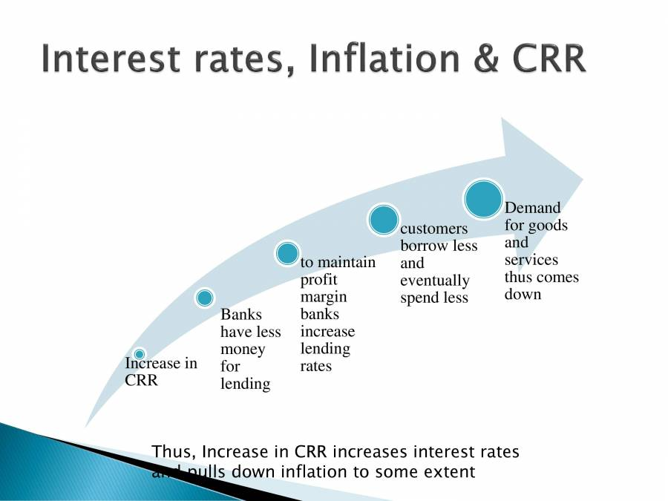

Slide 11
SLR
Every Scheduled commercial bank(SCB) in India is required to maintain a minimum proportion of their Net Demand and Time Liabilities as liquid assets in:
cash, or in gold valued at a price not exceeding the current market price, or
In unencumbered investment in the following instruments:
Treasury Bills of the Government of India; State Development Loans (SDLs); any other instrument as may be notified by the Reserve Bank of India
Maximum limit of SLR is 40%
What is SLR? It's like a safety net for banks. They need to keep some of their money in assets that can be quickly turned into cash. This ensures that banks have enough money on hand to meet the demands of their customers, like withdrawals.
What assets can banks use for SLR? They can keep their money in different forms: cash, gold, or specific types of investments like Treasury Bills of the Government of India, State Development Loans, or other assets approved by the RBI.
Why does RBI set SLR? It's a way to make sure banks stay stable and can handle any sudden financial stress. By having enough liquid assets, banks can avoid running out of cash during tough times.
What's the maximum limit of SLR? RBI sets a maximum limit, which is currently 40%. This means banks can't put more than 40% of their total funds into these liquid assets. They still need to use the rest of their money for lending and other banking activities

Slide 12
Current CRR, SLR, REPO & REVERSE REPO
CRR 4.50%
SLR 18%
REPO 6.50%
REVERSE REPO 3.35%

